Slide 1
Scripting your
Linux Auditing and Hardening tasks
Cybersecurity
Lesson 10.3

Slide 3

Learning Objectives
Today’s lesson will cover:
1
A brief overview of project tasks for Day 3.
2
Overview of deliverables for Project 1.
2
Project work.

Slide 4

Day 3 Project Overview

Slide 5

Day 3 Project Tasks
Steps you will be working on today:
Scripting your hardening tasks
Scheduling your hardening scripts
Completing the summary report

Slide 6

Day 3 Project Tasks
Scripting your hardening tasks
You will build out two scripts to automate many of the tasks you
have completed.
Ensure to test your scripts and confirm there are no errors.

Slide 7
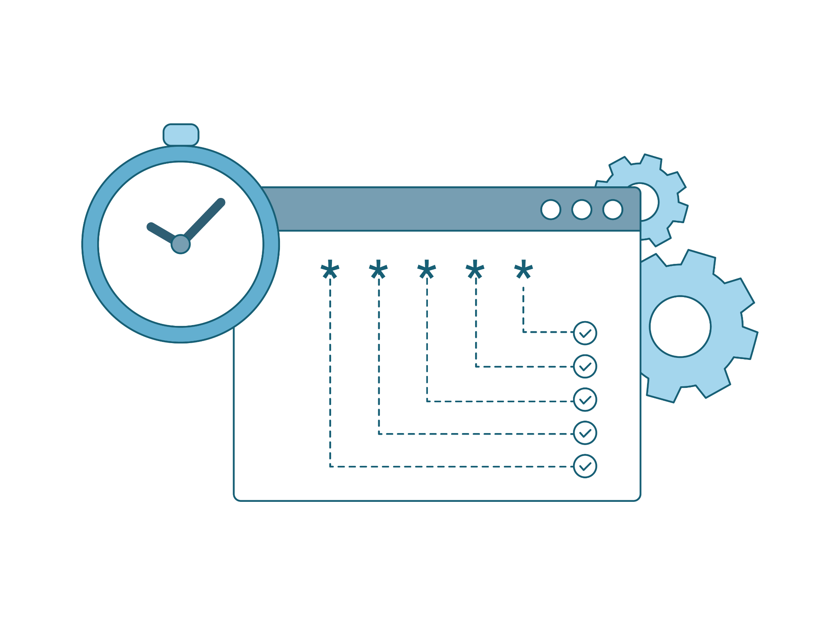
Day 3 Project Tasks
Scheduling your hardening scripts
After you have designed your scripts, Part 2 will have you schedule the two different scripts with cron jobs.

Slide 8

Day 3 Project Tasks
Completing the summary report
For the last activity, you will be tasked with completing your summary report.
In your report, include:
Tasks that have been checked off
All commands built

Slide 10
Hardening your Linux server
For the remainder of today's class, you will work on completing Day 3
project tasks.
While you are responsible for completing your own project, you can ask classmates, the TA, or the instructor to assist if you have any questions.
Remember to complete the checklist document as you progress through the activities.
Remainder of class

Slide 13

Project Conclusion
Project 1
Congratulations on completing your first project!

Slide 14
Day 3: Scripting your Linux auditing and hardening tasks

